Slide 1
PART 3.0: PROBLEM SOLVING - SEARCHING
Part 3.1 General introduction to searching
Part 3.2 Uninformed (Blind)/
Part 3.3 Informed (Heuristic) search
Part 4.0 Game playing search
APT 3010A:FALL SEMESTER
Facilitator :Fredrick Michael Ogore
Notes:
Part1-Search

Slide 2
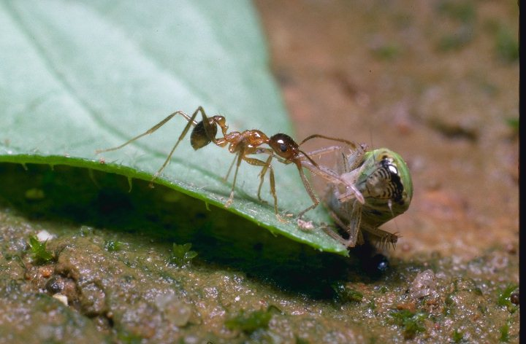
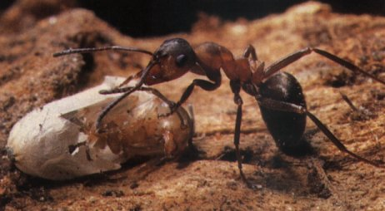
WORKERS ARE ALWAYS SEARCHING
Brief info on Ants, http://www.winnipeg-bugline.com/ants.html,
http://www.boston.com/globe/magazine/2002/0623/frontiers.htm

Slide 3
PROBLEM SOLVING TECHNIQUES IN A.I
Problem-solving in Artificial Intelligence usually refers to researching a solution to a problem by performing logical algorithms, utilizing polynomial and differential equations, and executing them using modeling paradigms.
There can be various solutions to a single problem, which are achieved by different heuristics.

Slide 4
PROBLEM SOLVING TECHNIQUES IN A.I
These are the following steps which require to solve a problem :
1.Goal Formulation:
This one is the first and simple step in problem-solving.
It organizes finite steps to formulate a target/goals which require some action to achieve the goal.
Today the formulation of the goal is based on AI agents.

Slide 5
PROBLEM SOLVING TECHNIQUES IN A.I
2.Problem formulation:
It is one of the core steps of problem-solving which decides what action should be taken to achieve the formulated goal.
In AI this core part is dependent upon software agent which consisted of the following components to formulate the associated problem.

Slide 6
PROBLEM SOLVING TECHNIQUES IN A.I
Broad Approaches
  using search techniques
    e.g. in Games
  modeling
    using Knowledge Base Systems (KBS)
    using Machine Learning techniques e.g. Artificial Neural Networks, Decision Trees, Case-base reasoning, Genetic algorithms, ..

Slide 7
SEARCHING AS A PROBLEM SOLVING TECHNIQUE
Searching is the process of looking for the solution of a problem through a set of possibilities (state space).
Search conditions include:
  Current state -where one is;
  Goal state – the solution reached; check whether it has been reached;
  Cost of obtaining the solution.
The solution is a path from the current state to the goal state.

Slide 8
SEARCHING AS A PROBLEM SOLVING TECHNIQUE
Process of Searching
Searching proceeds as follows:
  Check the current state;
  Execute allowable actions to move to the next state;
  Check if the new state is the solution state; if it is not, then the new state becomes the current state and the process is repeated until a solution is found or the state space is exhausted.

Slide 9
SEARCH PROBLEM
The search problem consists of finding a solution plan, which is a path from the current state to the goal state.
Representing search problems
  A search problem is represented using a directed graph. The states are represented as nodes while the allowed steps or actions are represented as arcs.
A search problem is defined by specifying:
  State space;
  Start node;
  Goal condition, and a test to check whether the goal condition is met;
  Rules giving how to change states.
  Path cost

Slide 10
SEARCH PROBLEM
Components to formulate the associated problem: Initial State: This state requires an initial state for the problem which starts the AI agent towards a specified goal. In this state new methods also initialize problem domain solving by a specific class.
Action: This stage of problem formulation works with function with a specific class taken from the initial state and all possible actions done in this stage.
Transition: This stage of problem formulation integrates the actual action done by the previous action stage and collects the final stage to forward it to their next stage.

Slide 11
SEARCH PROBLEM
Goal test: This stage determines that the specified goal achieved by the integrated transition model or not, whenever the goal achieves stop the action and forward into the next stage to determines the cost to achieve the goal.
Path costing: This component of problem-solving numerical assigned what will be the cost to achieve the goal. It requires all hardware software and human working cost.

Slide 12
PROBLEM DEFINITION - EXAMPLE, 8 PUZZLE
5
4
6
1
8
1
2
3
7
3
2
4
5
6
1
2
3
Initial State
7
8
8
4
7
6
5
1
4
7
2
5
8
3
6
Goal State

Slide 13
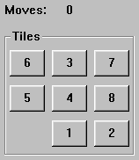
PROBLEM DEFINITION - EXAMPLE, 8 PUZZLE
States
  A description of each of the eight tiles in each location that it can occupy. It is also useful to include the blank
Operators/Action
  The blank moves left, right, up or down
Goal Test
  The current state matches a certain state (e.g. one of the ones shown on previous slide)
Path Cost
  Each move of the blank costs 1

Slide 14
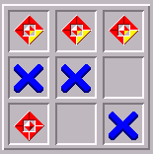
PROBLEM DEFINITION - EXAMPLE, TIC-TAC-TOE
x
o
o
o
x
x
x
x
x
x
x
x
o
x
x
x
o
x
x
x
o
o
o
x
x
x
o
………..
o
x
x
x
x
x
x
x
x
x
x
o
o
o
o

Slide 15
TREE/PATH EXAMPLE:
4
4
3
A
B
C
S
5
5
G
4
D
E
F
3
2
4
Implicit network of towns
Two possible tasks:
  1. FIND a (the) path. = computational cost
  2. TRAVERSE the path. = travel cost
2. relates to finding optimal paths

Slide 16
The associated loop-free tree of partial paths
4
4
3
A
B
C
S
5
5
G
4
3
D
2
E
4
F
3
S
4
4
A
D
2
5
5
B
D
A
E
4
5
2
4
5
4
C
2
E
4
5
E
B
B
F
4
4
5
4
4
3
D
F
B
F
C
E
A
C
G
3
4
3
4
G
C
G
F
3
G

Slide 17
PATHS:
We are not interested in optimal paths here, so we can drop the costs.
Denotes:
SA
S
A
Denotes:SDA
D
B
D
A
E
C
E
E
B
B
F
D
F
B
F
C
E
A
C
G
G
C
G
F
Denotes:
SDEBA
G
Nodes do not denote themselves, but denote the partial path from the root to themselves!!

Slide 18
TERMINOLOGY:
S
A
D
B
D
A
E
C
E
E
B
B
F
D
F
B
F
C
E
A
C
G
G
C
G
F
G
Node, link (or edge), branch, arc
Parent, child, ancestor, descendant
Root node, goal node
Expand / Open node / Closed node / Branching factor

Slide 19
USING A TREE – THE OBVIOUS SOLUTION?
But
  It can be wasteful on space
  It can be difficult to implement, particularly if there are varying number of children (as in tic-tac-toe)
  It is not always obvious which node to expand next. We may have to search the tree looking for the best leaf node (sometimes called the fringe or frontier nodes). This can obviously be computationally expensive

Slide 20
HOW GOOD IS A SOLUTION?
Does our search method actually find a solution?
Is it a good solution?
  Path Cost
  Search Cost (Time and Memory)
Does it find the optimal solution?
  But what is optimal?

Slide 21
EVALUATING A SEARCH
Completeness
  Is the strategy guaranteed to find a solution?
Time Complexity
  How long does it take to find a solution?
Space Complexity
  How much memory does it take to perform the search?
Optimality
  Does the strategy find the optimal solution where there are several solutions?

Slide 22
SEARCH TREES
Some issues:
  Search trees grow very quickly
  The size of the search tree is governed by the branching factor
  Even this simple game tic-tac-toe has a complete search tree of 984,410 potential nodes
  The search tree for chess has a branching factor of about 35

